Slide 1


Pacman Project
CS 110
Developed by:
Abdelrahman Abdelmonem
Abdallah Taha
Amer Elsheikh
Supervised by:
Dr. Howaida Ismail

Slide 2
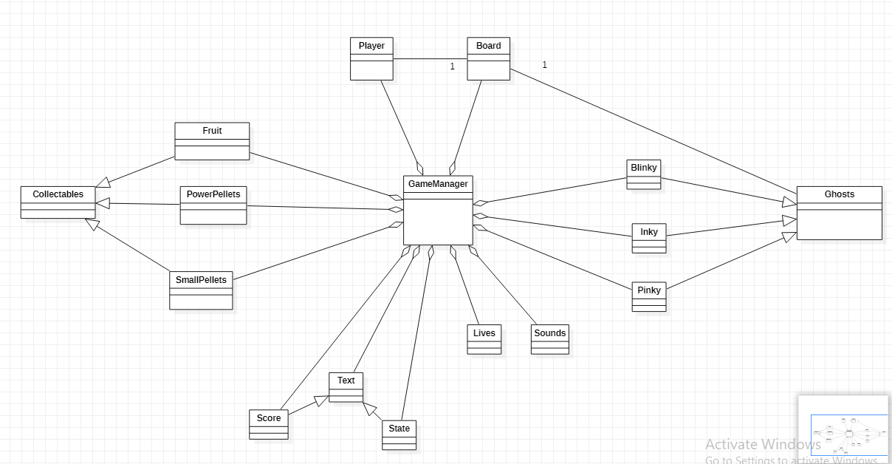
General Structure

Slide 3

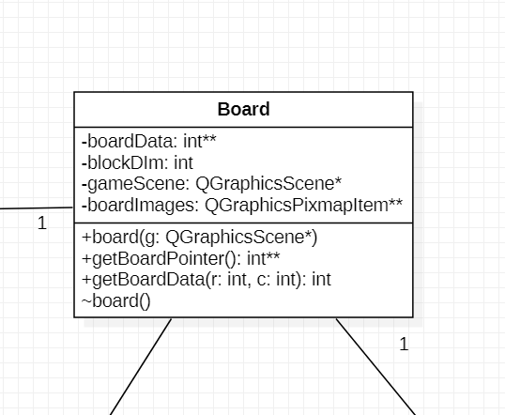

Board
-Reads and saves board.txt using QFile and QTextStream.
-Initializes QPixmaps with the right size and image.
-Sets them in QGraphicsPixmapItem array with their correct position and adds them to the scene.
getBoardData and getBoardPointer returns boardData.

Slide 4

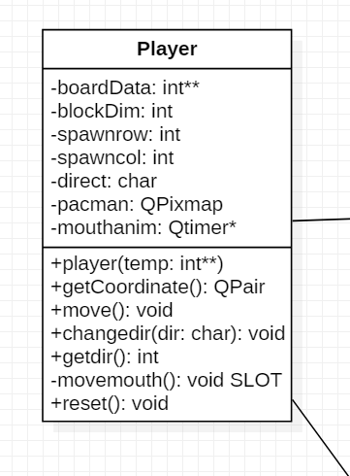
Player
Inherits QGraphicsPixmapItem.
When player is initialized it takes the board data as an argument and stores it.
Pacman image is loaded and pacman is spawned in its default spawn.
We can get its direction and coordinates using getdir() and getCoordinate().
movemouth() handles pacman smooth motion.

Slide 5

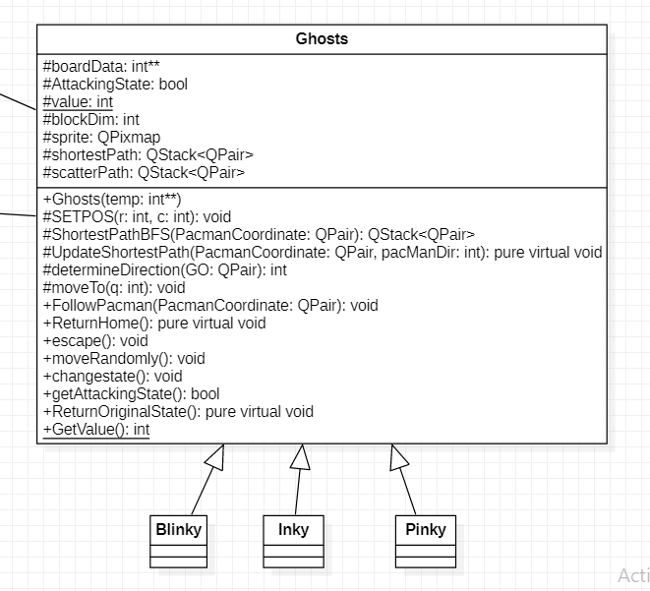
Ghosts
Inherits from QGraphicsPixmapItem
Value: static and doubles
Smoothness
Escaping mode:
changestate()
escape(): away then randomly
Not eaten: ReturnOriginalState():pure
Eaten: ReturnHome(): pure
Following mode:
ScatterPath
FollowPacman()
UpdateShortestPath(): pure
ShortestPathBFS()
Notes:
Value setted when pacman eats a power pellet or when it is eaten

Slide 6
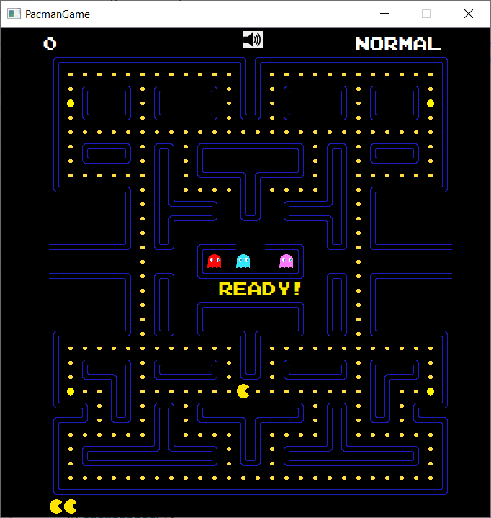

Slide 7
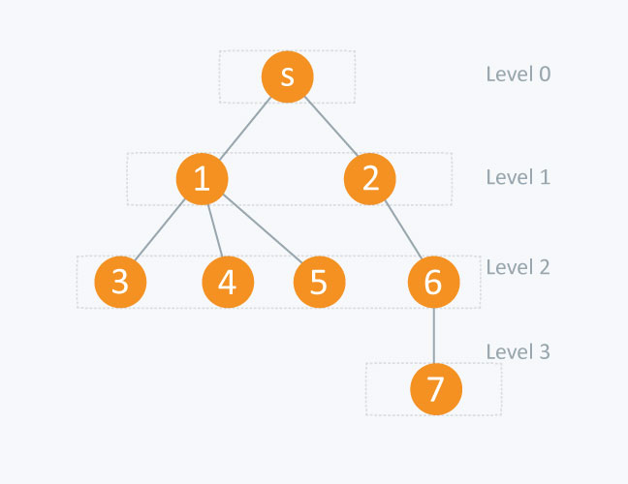
ShortestPathBFS
The graph is unweighted and connected; the nearest node is always at the front of the queue

Slide 8
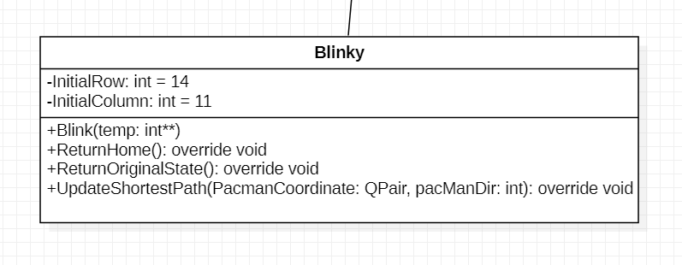

Blinky

Slide 9

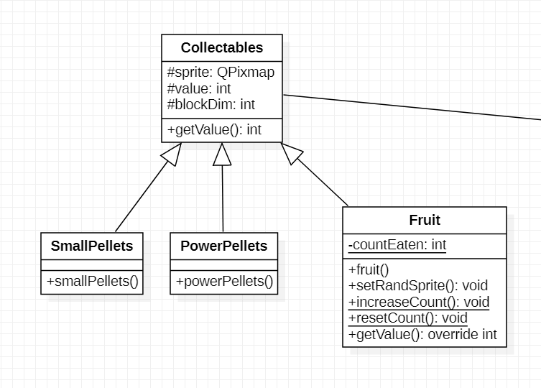
Collectables - inherits QGraphicsPixmapItem
Pellets: -Initilizes value and QPixmap with right image and the right size. -Sets QPixmap to QGraphicsPixmapItem.
Fruit: -one fruit object that changes position and image randomly. -setRandSprite, generates a random number by qrand() and loads a random image with the right size. -Keep track of eaten fruit.
*Positions and adding to the scene is done in gamemanager..

Slide 10
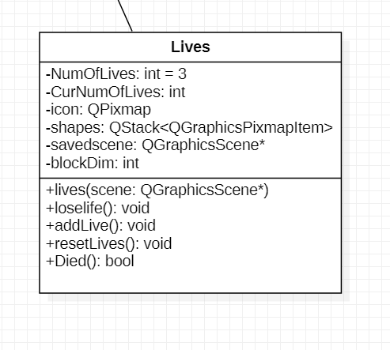



Lives
Lives is a simple class.
It is created to keep track of lives.
Lives class takes the current scene as an argument for the constructor.
Lives are add to the scene based on a stack.

Slide 11

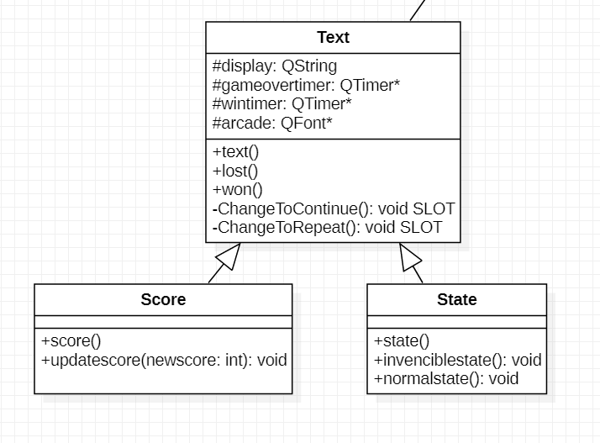
Text
Text has the format of any text used in the game.
Score and State differ in the place each one appears on and their operations.
Text is used to show messages for the user.
Score shows player’s score.
State shows pacman’s state.

Slide 12

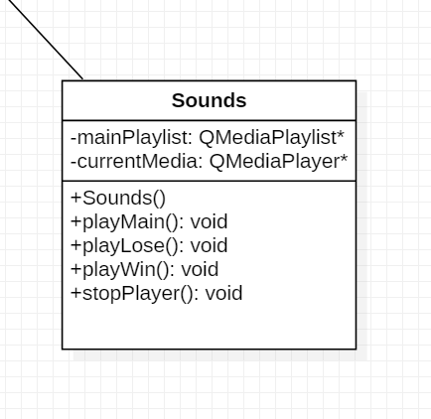
Sound
The sound class is pretty simple and fun.
-Initializes QMediaPlaylist (mainPlaylist) and adds to it our sounds/music. -Creates a QMediaPlayer (currentMedia) and connects it to our playlist. Functions - They do pretty much the same thing, they set a specific music and playBackMode in the QMediaPlaylist and then calls currentMedia.play

Slide 13
GameManager
Functions

Slide 14
GameManager()
Sets puts the scene on the view and sets its color to black.
Creates instances from the board, ghosts, pacman, lives, texts, and the mute button.
Initializes and connects timers to their slots.
Now, the game is ready!

Slide 15
Timers
timer
advance()

Slide 16
advance()
This is our main function, and it is called randomly every 18 milliseconds.
It first checks whether the user exceeded a multiple of 10 thousand or not, and assign new lives accordingly
Then it checks three types of collisions and handles them:
Small Pellets
Power Pellets
Ghosts
fruits
Then it checks if the user has died and act accordingly
If not died, then it checks if he won (eaten all pellets) and act accordingly
If not both, then it calls the functions that move the pacman and the ghosts according to their state (attacking or escaping)

Slide 17

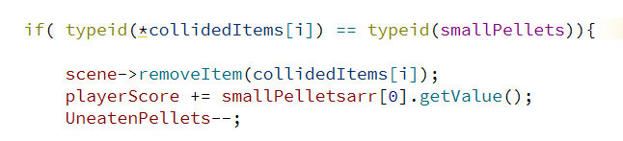
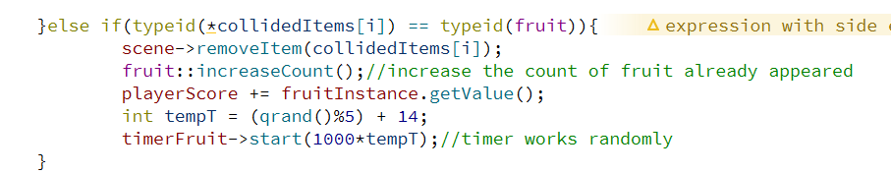
Collision with small pellets and fruit

Slide 18
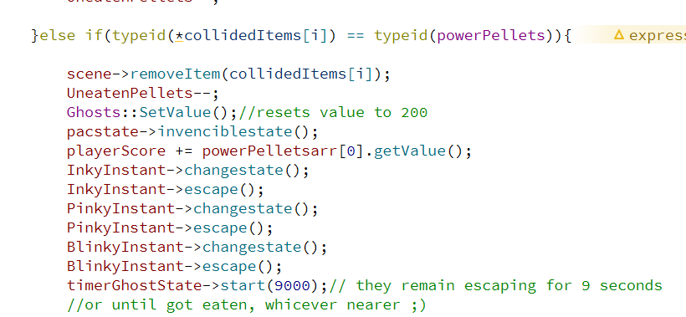
Collision with power pellets

Slide 19
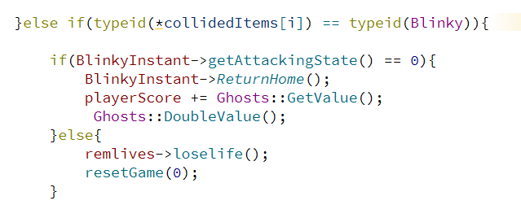
Collision with Ghosts (Blinky)

Slide 20
resetGame(bool win)
Called when pacman is eaten or when there is no more pellets.
It returns everything to its place.
If the player didn’t win we delay its start for smoother gameplay.

Slide 21
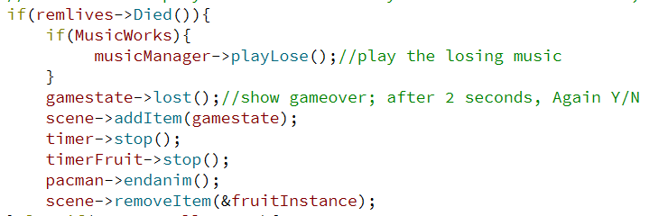
If pacman lost

Slide 22
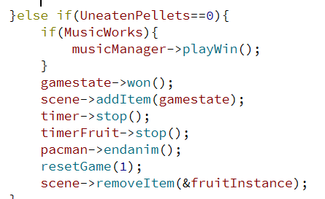
If pacman won

Slide 23
Collision with Ghosts (Blinky)

Slide 24
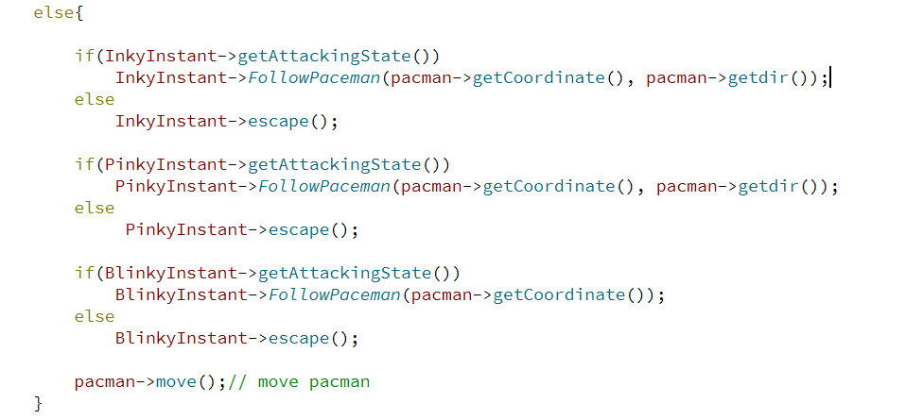
If pacman hasn’t won or lost yet

Slide 25
Timers
timer
advance()
timeFruit
createFruit()

Slide 26


createFruit()
This function is called randomly every 14 to 18 seconds.
Calls setRandSprite on our fruit instance, and then sets a random position on the board and adds it to the scene.
It resets the timer with a different value between 14 and 18 sec.
If the fruit already exists on the board it will change its position and its image randomly.

Slide 27
Timers
timer
advance()
timeFruit
createFruit()
timerGhostState
ghostStateTimeout()

Slide 28
ghostStateTimeout()
If there is a ghost that is still scared, its state is changed back to chasing pacman.
Changes the text on the screen.

Slide 29
Timers
timer
advance()
timeFruit
createFruit()
timerGhostState
ghostStateTimeout()
delay
delayStart()

Slide 30
delayStart()
Designed to delay the start of the game after reset to give the better playing experience.
Starts pacman’s mouth animation and the game’s main timer again.

Slide 31
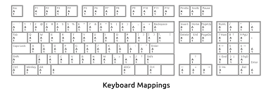
KeyPressEvent()
It is a vital and crucial function as it handles all input.
There are 4 different (phases), in each phase we accept certain input.
These phases are: -The game hasn’t started: we check for space key. -The game is running: we check directional inputs and change pacman direction. -The player is dead: we check Y/N key and either start a new game and reset everything (score, lives, fruit) or close it. -The player has won: we check Y/N key and either continue the game or close it.
*player has won equivalent uneaten pellets = 0;

Slide 32
startAgain()
Called if the user wants to play again.
It fills the pellets again and starts the timers.
It plays the appropriate music as well.

Slide 33

FillPellets()
When it is called it adds and sets the position of the pellets in the scene.
We initialize the number of unEatenPellets = 248.
We loop over the boardData.
We check if the row and col has the right value and set position if it does.

Slide 34


OnMusicClicked()
This is a slot function that is connected to the signal clicked() of a QPushButton.
It mutes or plays the sounds of the game once the button is clicked.
The QPushButton is initialized in the gameManager constructor.
When it is called it checks bool MusicWorks. In case it is true, it changes the icon, sets MusicWorks to false, and calls stop on sound class.

